Slide 1
Introduction to Embedded Systems Design
Dr. Alex Dean

Slide 2
Introduction
What is an Embedded System?
Application-specific computer system
Built into a larger system
Why add a computer to the larger system?
Better performance
More functions and features
Lower cost
More dependability
Economics
Microcontrollers (used for embedded computers) are high-volume, so recurring cost is low
Nonrecurring cost dominated by software development
Networks
Often embedded system will use multiple processors communicating across a network to lower parts and assembly costs and improve reliability

Slide 3
Options for Building Embedded Systems
Implementation | Design Cost | Unit Cost | Upgrades & Bug Fixes | Size | Weight | Power | System Speed
Discrete Logic | low | mid | hard | large | high | ? | very fast
ASIC | high ($500K/ mask set) | very low | hard | tiny - 1 die | very low | low | extremely fast
Programmable logic – FPGA, PLD | low | mid | easy | small | low | medium to high | very fast
Microprocessor + memory + peripherals | low to mid | mid | easy | small to med. | low to moderate | medium | moderate
Microcontroller (int. memory & peripherals) | low | mid to low | easy | small | low | medium | slow to moderate
Embedded PC | low | high | easy | medium | moderate to high | medium to high | fast
Dedicated Hardware
Software Running on Generic Hardware
Notes:
There are many possible ways to embed processing within a device. We can design custom, dedicated hardware using individual logic chips, custom chips (ASICs) or programmable logic chips. Alternatively we can customize our program and try to use a standard computer processor, greatly reducing the hardware development needed. There are various tradeoffs to each approach.

Slide 4
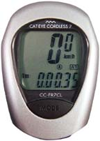
Example Embedded System: Bike Computer
Functions
Speed and distance measurement
Constraints
Size
Cost
Power and Energy
Weight
Inputs
Wheel rotation indicator
Mode key
Output
Liquid Crystal Display
Low performance MCU
8-bit, 10 MIPS
Notes:
This is a simple embedded system which has tight cost and power/energy constraints. Most of the time it is not doing anything and in a sleep mode to save power.

Slide 5
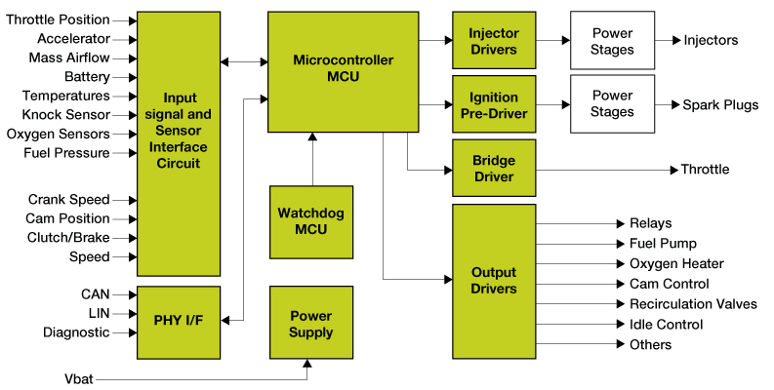
Gasoline Automobile Engine Control Unit
Functions
Fuel injection
Air intake setting
Spark timing
Exhaust gas circulation
Electronic throttle control
Knock control
Constraints
Reliability in harsh environment
Cost
Weight
Many Inputs and Outputs
Discrete sensors & actuators
Network interface to rest of car
High Performance MCU
32-bit, 3 MB flash memory, 150 - 300 MHz
Image courtesy of Freescale
Notes:
An automotive engine control unit is much more complex, managing many functions, reading many sensors, controlling many actuators, and communicating on multiple vehicle networks. It uses a much faster processor with more memory.

Slide 6
Benefits of Embedded Computer Systems
Greater performance and efficiency
Software makes it possible to provide sophisticated control
Lower costs
Less expensive components can be used
Manufacturing costs reduced
Operating costs reduced
Maintenance costs reduced
More features
Many not possible or practical with other approaches
Better dependability
Adaptive system which can compensate for failures
Better diagnostics to improve repair time
Notes:
Why go to the trouble of adding an embedded computer system to a device? Here’s why.

Slide 7
Embedded System Functions
Closed-loop control system
Monitor a process, adjust an output to maintain desired set point (temperature, speed, direction, etc.)
Sequencing
Step through different stages based on environment and system
Signal processing
Remove noise, select desired signal features
Communications and networking
Exchange information reliably and quickly
Notes:
What do embedded systems typically need to do? Here are some examples.

Slide 8
Attributes of Embedded Systems
Interfacing with larger system and environment
Analog signals for reading sensors
Typically use a voltage to represent a physical value
Power electronics for driving motors, solenoids
Digital interfaces for communicating with other digital devices
Simple - switches
Complex - displays

Slide 9
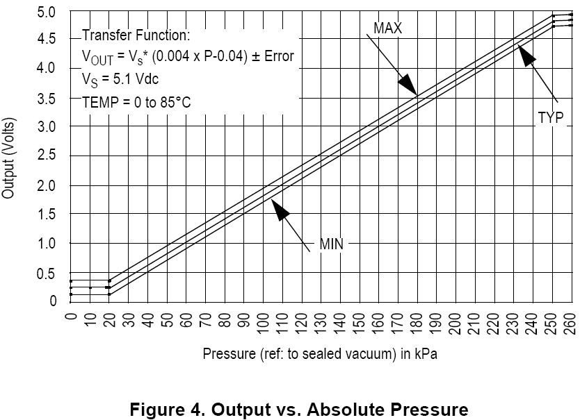
Example Analog Sensor - Depth Gauge
V_ref
// Your software
ADC_Code = ADC0->R[0];
V_sensor = ADC_code*V_ref/1023;
Pressure_kPa = 250 * (V_sensor/V_supply+0.04);
Depth_ft = 33 * (Pressure_kPa – Atmos_Press_kPa)/101.3;
Pressure Sensor
Analog to Digital Converter
Pressure
Voltages
ADC Output Codes
V_sensor
ADC_Code
V_ref
111..111
111..110
111..101
111..100
V_sensor
ADC_Code
Ground
000..001
000..000
Sensor detects pressure and generates a proportional output voltage V_sensor
ADC generates a proportional digital integer (code) based on V_sensor and V_ref
Code can convert that integer to a something more useful
first a float representing the voltage,
then another float representing pressure,
finally another float representing depth
Notes:
Here’s an example of how we can calculate how deep underwater an object is by using the fact that the water pressure is proportional to depth. We start by measuring the water pressure.

Slide 10
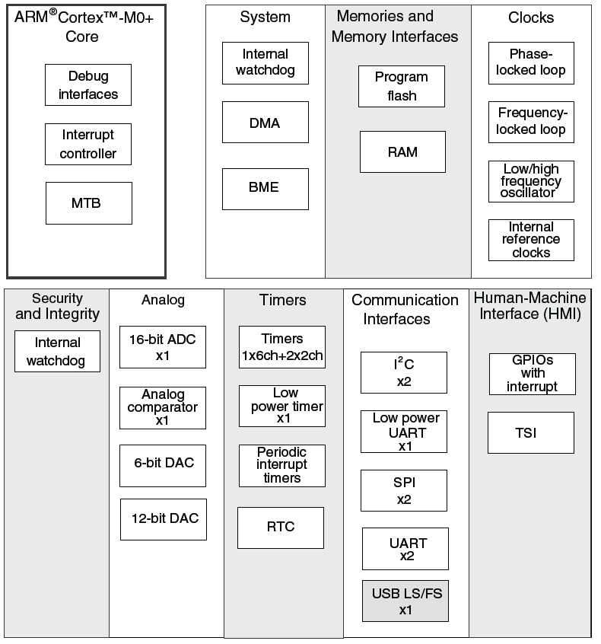
Microcontroller vs. Microprocessor
Both have a CPU core to execute instructions
Microcontroller has peripherals for concurrent embedded interfacing and control
Analog
Non-logic level signals
Timing
Clock generators
Communications
point to point
network
Reliability and safety
Notes:
What is the difference between an MCU and an MPU? The MCU has extra hardware to allow it to interface with the outside world more easily, and to simplify processing multiple tasks concurrently.

Slide 11
Attributes of Embedded Systems
Concurrent, reactive behaviors
Must respond to sequences and combinations of events
Real-time systems have deadlines on responses
Typically must perform multiple separate activities concurrently

Slide 12
MCU Hardware & Software for Concurrency
CPU executes instructions from one or more thread of execution
Specialized hardware peripherals add dedicated concurrent processing
DMA - transferring data between memory and peripherals
Watchdog timer
Analog interfacing
Timers
Communications with other devices
Detecting external signal events
Peripherals use interrupts to notify CPU of events

Slide 13
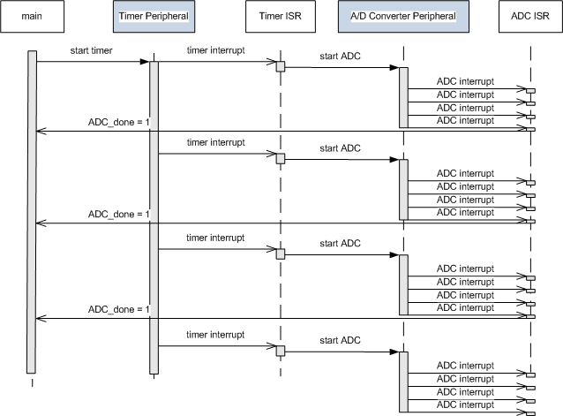
Concurrent Hardware & Software Operation
Software
Hardware
Software
Hardware
Software
Time
Embedded systems rely on both MCU hardware peripherals and software to get everything done on time
Notes:
We can use a sequence diagram to show how the different components in the system interact with each other as time progresses.
Here we see that main function starts a hardware timer running, which in turn generates an interrupt, which is serviced by another software function (timer ISR), which starts another hardware component running (ADC), which results in several additional interrupts, each of which is handled by yet another software function (ADC ISR).

Slide 14
Attributes of Embedded Systems
Fault handling
Many systems must operate independently for long periods of time, requiring system to handle likely faults without crashing
Often fault-handling code is larger and more complex than the normal-case code
Diagnostics
Help service personnel determine problem quickly
Notes:
Embedded systems are expected to work and be easy to fix, so often there is a lot of code to handle special cases, errors and faults.

Slide 15
Constraints
Cost
Competitive markets penalize products which don’t deliver adequate value for the cost
Size and weight limits
Mobile (aviation, automotive) and portable (e.g. handheld) systems
Power and energy limits
Battery capacity
Cooling limits
Environment
Temperatures may range from -40°C to 125°C, or even more
Notes:
Embedded systems have constraints which depend on the product’s particular environment and market. Designs must meet these to be successful.

Slide 16
Impact of Constraints
Microcontrollers used (rather than microprocessors)
Include peripherals to interface with other devices, respond efficiently
On-chip RAM, ROM reduce circuit board complexity and cost
Programming language
Programmed in C rather than Java (smaller and faster code, so less expensive MCU)
Some performance-critical code may be in assembly language
Operating system
Typically no OS, but instead simple scheduler (or even just interrupts + main code (foreground/background system)
If OS is used, likely to be a lean RTOS

Slide 17
Curriculum Overview
Introductory Course: Building an Embedded System with an MCU
Microcontroller concepts
Software design basics
ARM Cortex M0+ architecture and interrupt system
C as implemented in assembly language
Peripherals and interfacing
Advanced Course: Performance Analysis and Optimizations
Creating responsive systems
Creating fast systems
Optimizing system power and energy

Slide 18
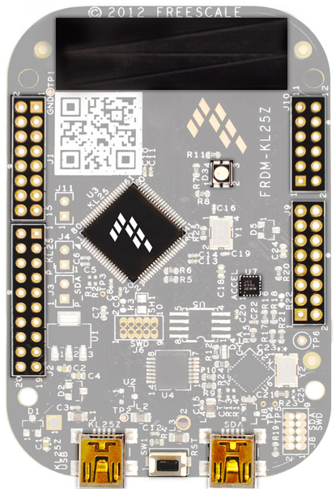
Target Board - FRDM-KL25Z
32-bit Cortex M0+ Processor Core
Freescale Kinetis MKL25Z128VLK4 processor
Extremely low power use
48 MHz max clock
On-chip 128 KB ROM, 16 KB RAM
Wide range of peripherals, including USB on-the-go
FRDM-KL25Z board
$13 (USD)
Peripherals: 3-axis accelerometer, RGB LED, capacitive touch slider
Expansion ports are compatible with Arduino shield ecosystem – endless opportunities, low-cost hardware
mbed.org enabled - online software development toolchain, reusable code

Slide 19
Why Are We…?
Using C instead of Java (or Python, or your other favorite language)?
C is the de facto standard for embedded systems because of:
Precise control over what the processor is doing.
Modest requirements for ROM, RAM, and MIPS, so much cheaper system
Predictable behavior, no OS (e.g. Garbage Collection) preemption
Learning assembly language?
The compiler translates C into assembly language. To understand whether the compiler is doing a reasonable job, you need to understand what it has produced.
Sometimes we may need to improve performance by writing assembly versions of functions.
Required to have a microcontroller board?
The best way to learn is hands-on.
You will keep these boards after the semester ends for possible use in other projects (e.g. Senior Design, Advanced Embedded System Design, Mechatronics, etc.)

